Slide 1
Rohan Bhandari
Insight AI Fellow

Slide 2

Inefficiency in the Online Clothing Marketplace
60% of returned clothes from online purchases are due to style
Results in $10B of extra operating costs
https://www.cnbc.com/2016/12/16/a-260-billion-ticking-time-bomb-the-costly-business-of-retail-returns.html
“Returns Management in Online Commerce - Making the Most of It”, University of Regensburg
Notes:
One-third of online retailers think that with a 10% lower return rate, their profits would increase by up to 5%

Slide 3
Inefficiency in the Online Clothing Marketplace
60% of returned clothes from online purchases are due to style
Results in $10B of extra operating costs
Potential for large cost savings!
https://www.cnbc.com/2016/12/16/a-260-billion-ticking-time-bomb-the-costly-business-of-retail-returns.html
“Returns Management in Online Commerce - Making the Most of It”, University of Regensburg
Notes:
One-third of online retailers think that with a 10% lower return rate, their profits would increase by up to 5%

Slide 4
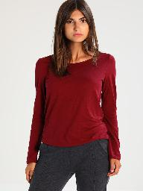
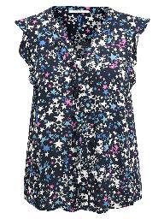
The SmartFit Service
Provide service to online retailers
Allow customers to virtually try-on clothing before buying
Simplify online purchasing and reduce returns
+

Slide 5
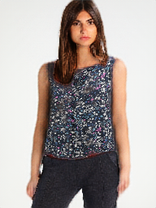
The SmartFit Service
Provide service to online retailers
Allow customers to virtually try-on clothing before buying
Simplify online purchasing and reduce returns
+

Slide 6
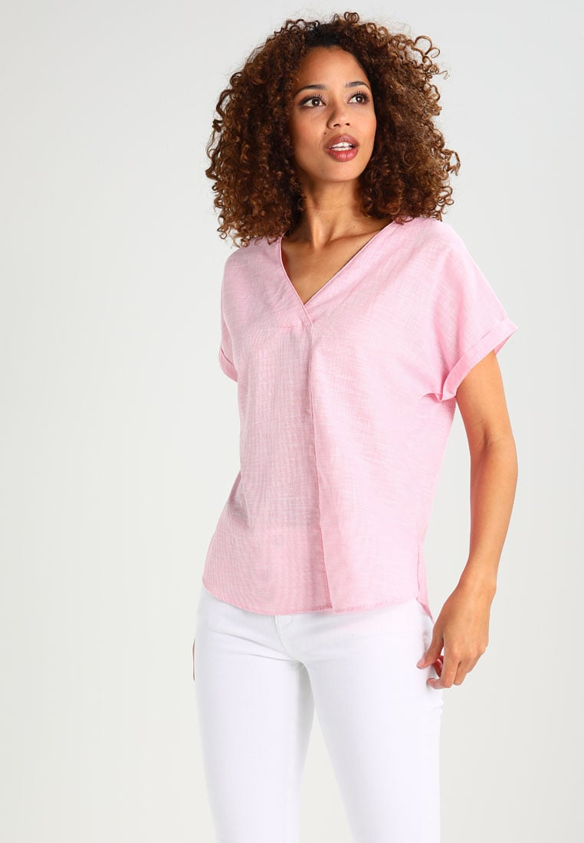
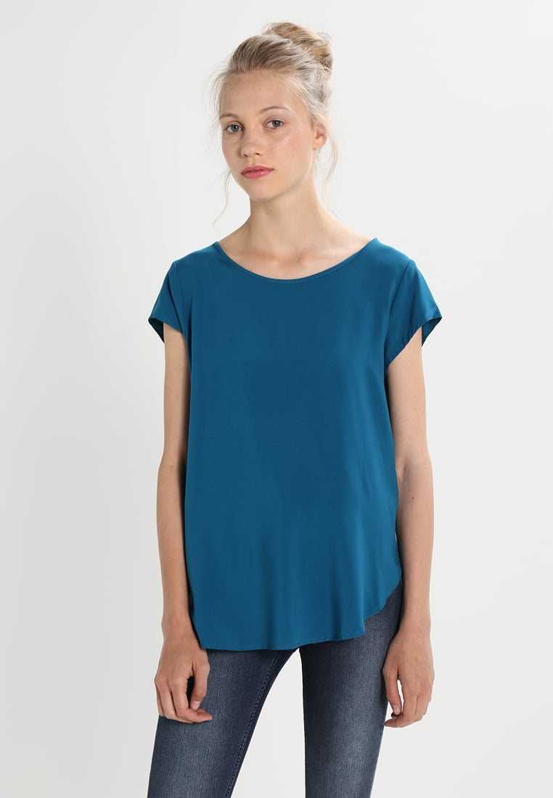
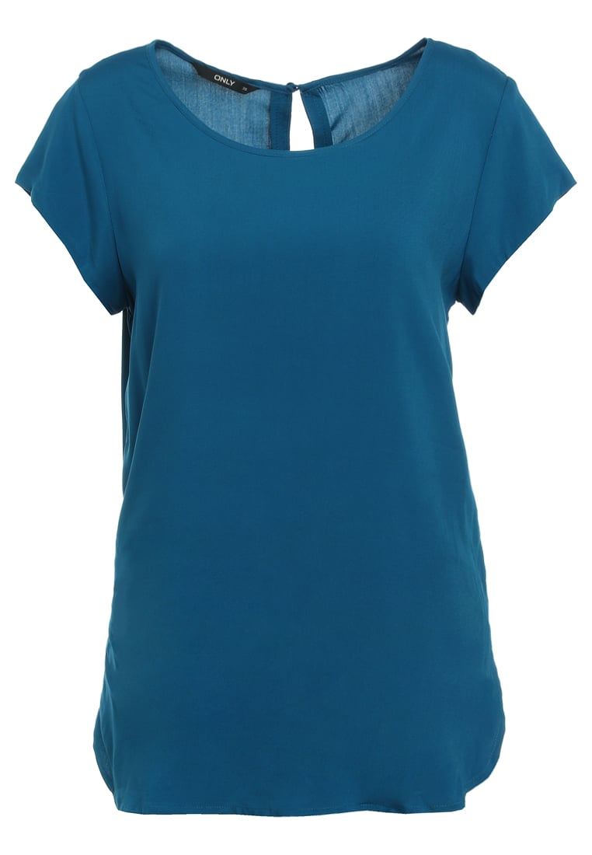
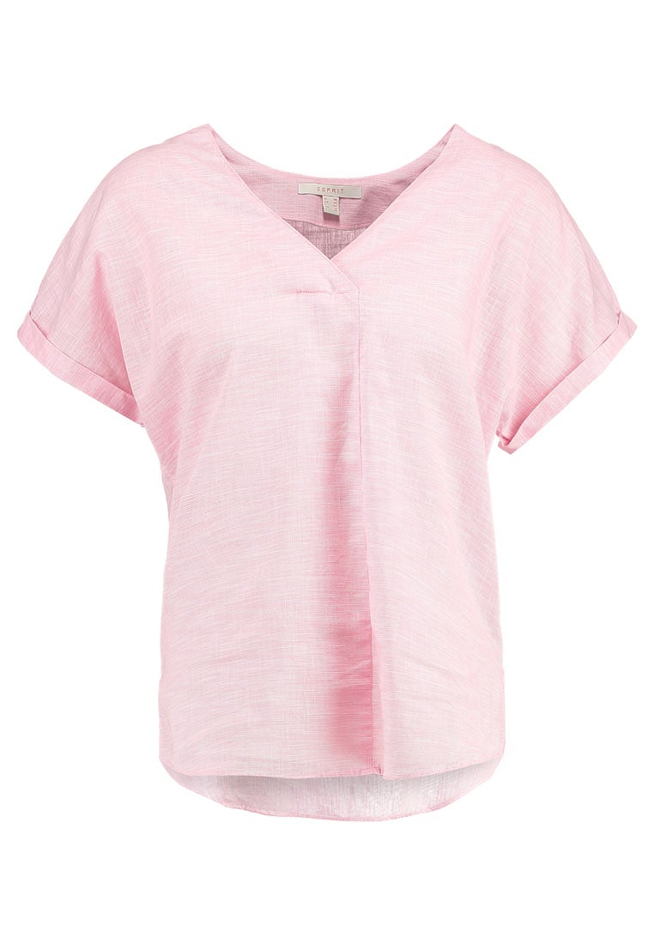
SmartFit Data
16,000 model-clothing pairs
14k train + 2k test
Only women’s tops
e-Commerce Fashion Dataset

Slide 7
SmartFit Pipeline
Inputs
Customer
Notes:
Gets the style
Fits it to the pose
Recognizes that its a t-shirt and removes the sleeves

Slide 8
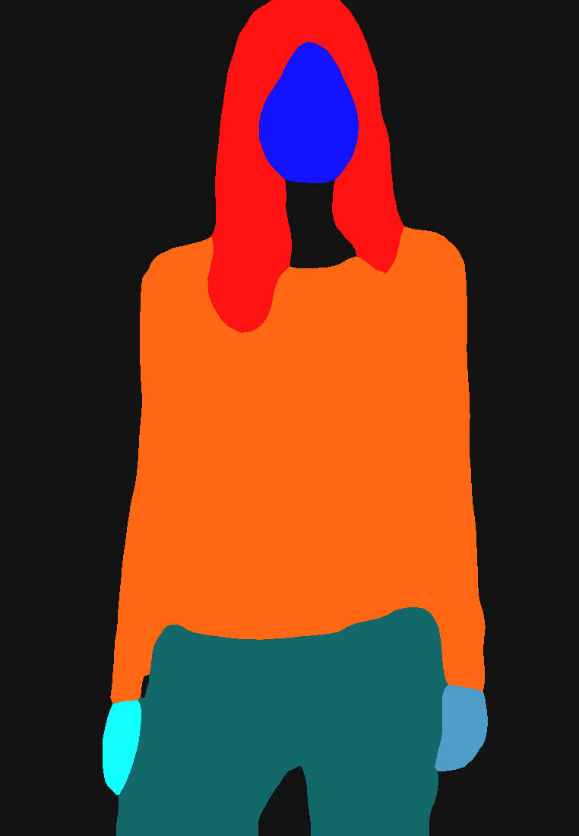
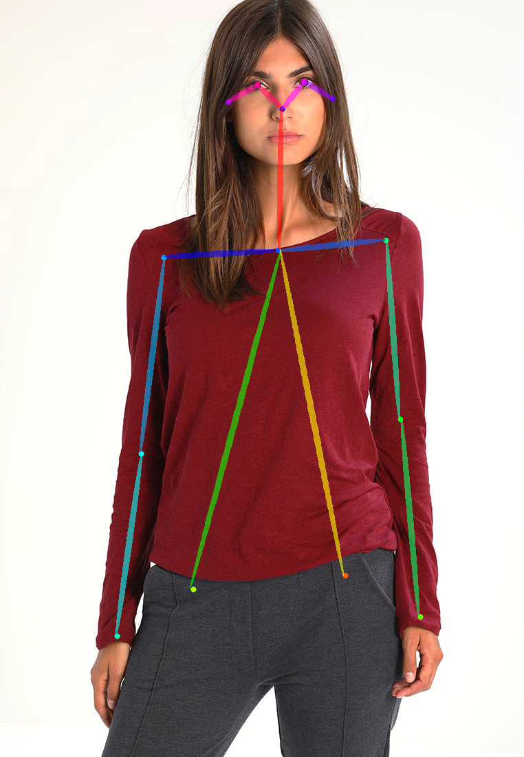
SmartFit Pipeline
Inputs
Human Parsing
Pose Estimation
Customer
Pre-trained
Model
Pre-trained
Model
+
Notes:
Gets the style
Fits it to the pose
Recognizes that its a t-shirt and removes the sleeves

Slide 9
SmartFit Pipeline
Inputs
Human Parsing
Pose Estimation
Clothing Transfer
Customer
Pre-trained
Model
Pre-trained
Model
Modified and Trained
Model
+
Notes:
Gets the style
Fits it to the pose
Recognizes that its a t-shirt and removes the sleeves

Slide 10
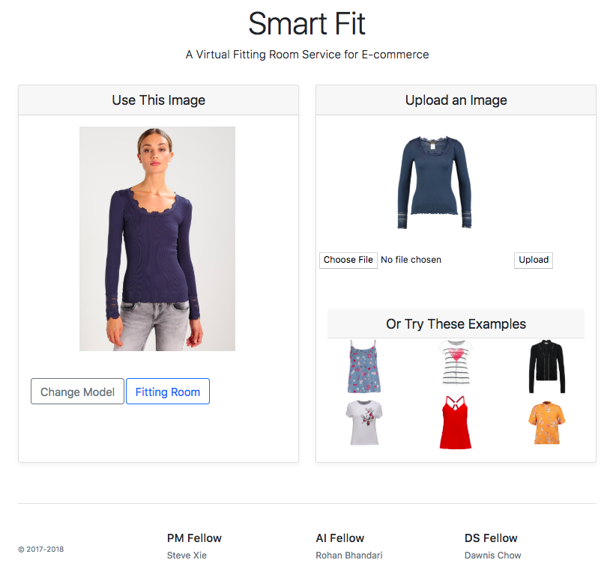
SmartFit Pipeline
Inputs
Human Parsing
Pose Estimation
Clothing Transfer
Serving
Customer
Pre-trained
Model
Pre-trained
Model
Modified and Trained
Model
Web App
via API
+
Notes:
Gets the style
Fits it to the pose
Recognizes that its a t-shirt and removes the sleeves

Slide 11

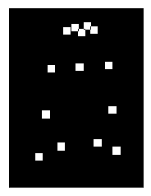
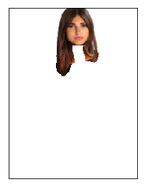
Clothing Transfer
“Clothing Agnostic”
Person Representation
Output
Selected Clothing
Encoder-decoder Network
w/ Skip Connections

Slide 12

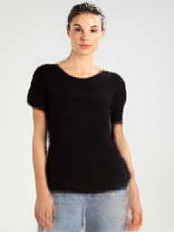
Keep Your Pants On
Model generates pants automatically → can’t try on specific outfits!
Original Person Representation
Green pants
Blue jeans

Slide 13
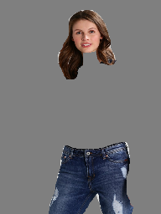
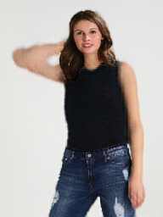
Keep Your Pants On
Model generates pants automatically → can’t try on specific outfits!
Original Person Representation
New Person Representation
Include pants
Green pants
Blue jeans

Slide 14
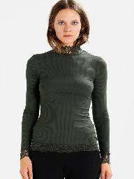
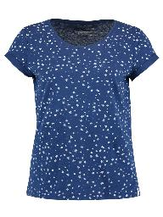
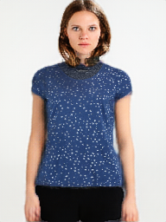
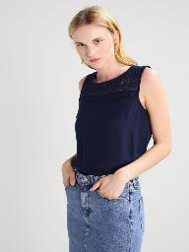
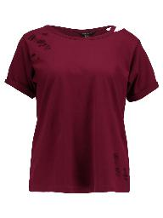
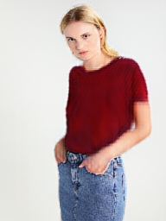
SmartFit Results
Preserves identity
Generates bare arms
Keeps original pants
Adjusts to pose
Notes:
Gets the style
Fits it to the pose
Recognizes that its a t-shirt and removes the sleeves

Slide 15
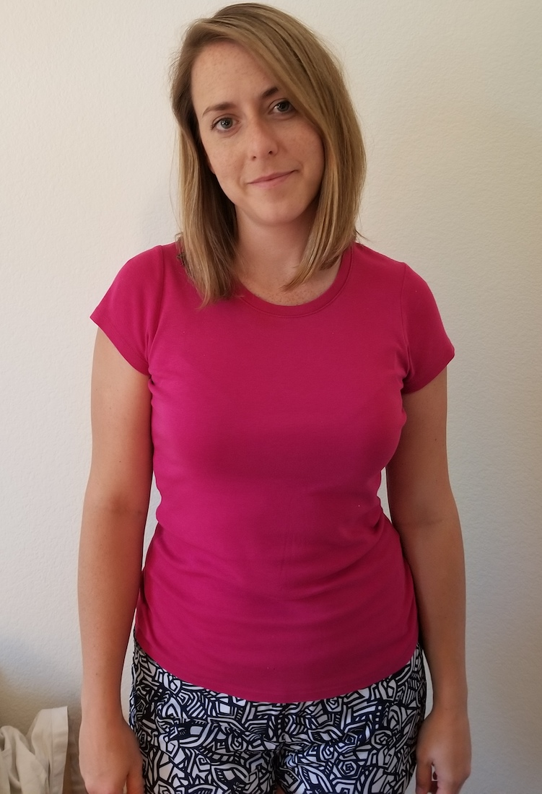
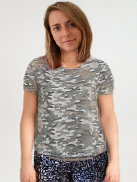
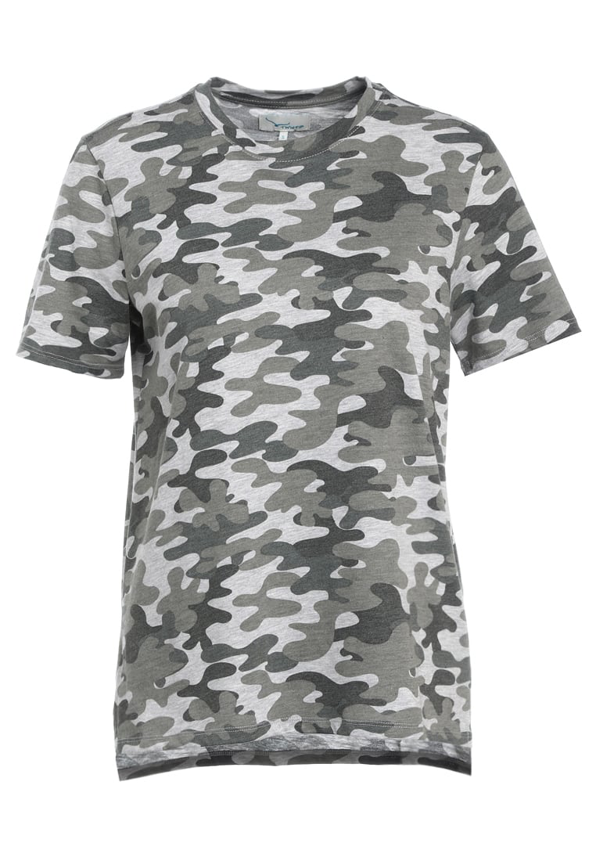
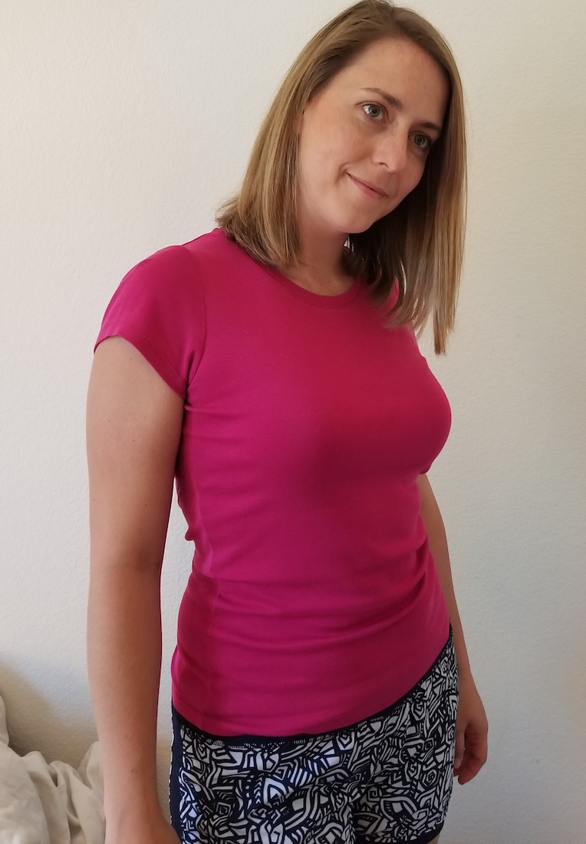
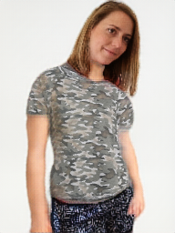
SmartFit Results: In the Wild
Real-world Examples
Notes:
Gets the style
Fits it to the pose
Recognizes that its a t-shirt and removes the sleeves

Slide 16

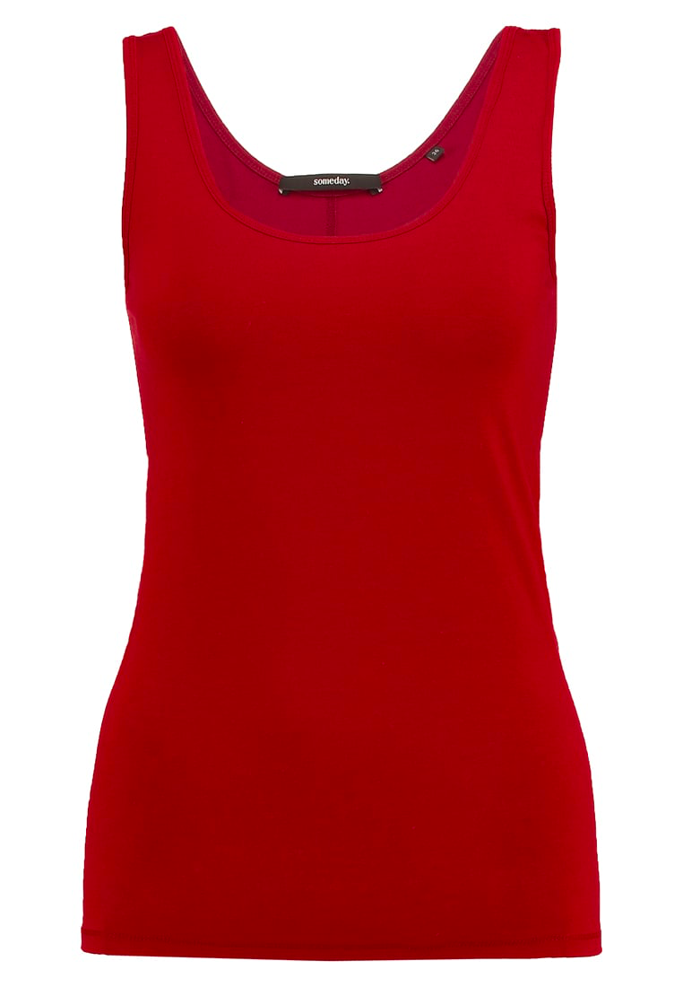
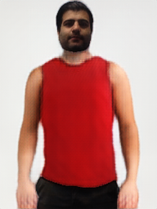
SmartFit Results: In the Wild
Real-world Examples
with some limitations...
Notes:
Gets the style
Fits it to the pose
Recognizes that its a t-shirt and removes the sleeves

Slide 17
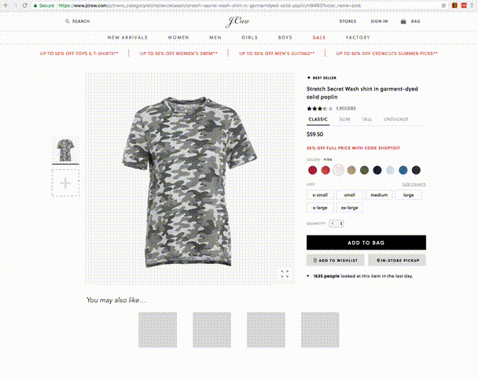
The SmartFit Experience
Customers can purchase confidently, knowing the style fits their taste
Simulated Images
Design by Chloe To

Slide 18





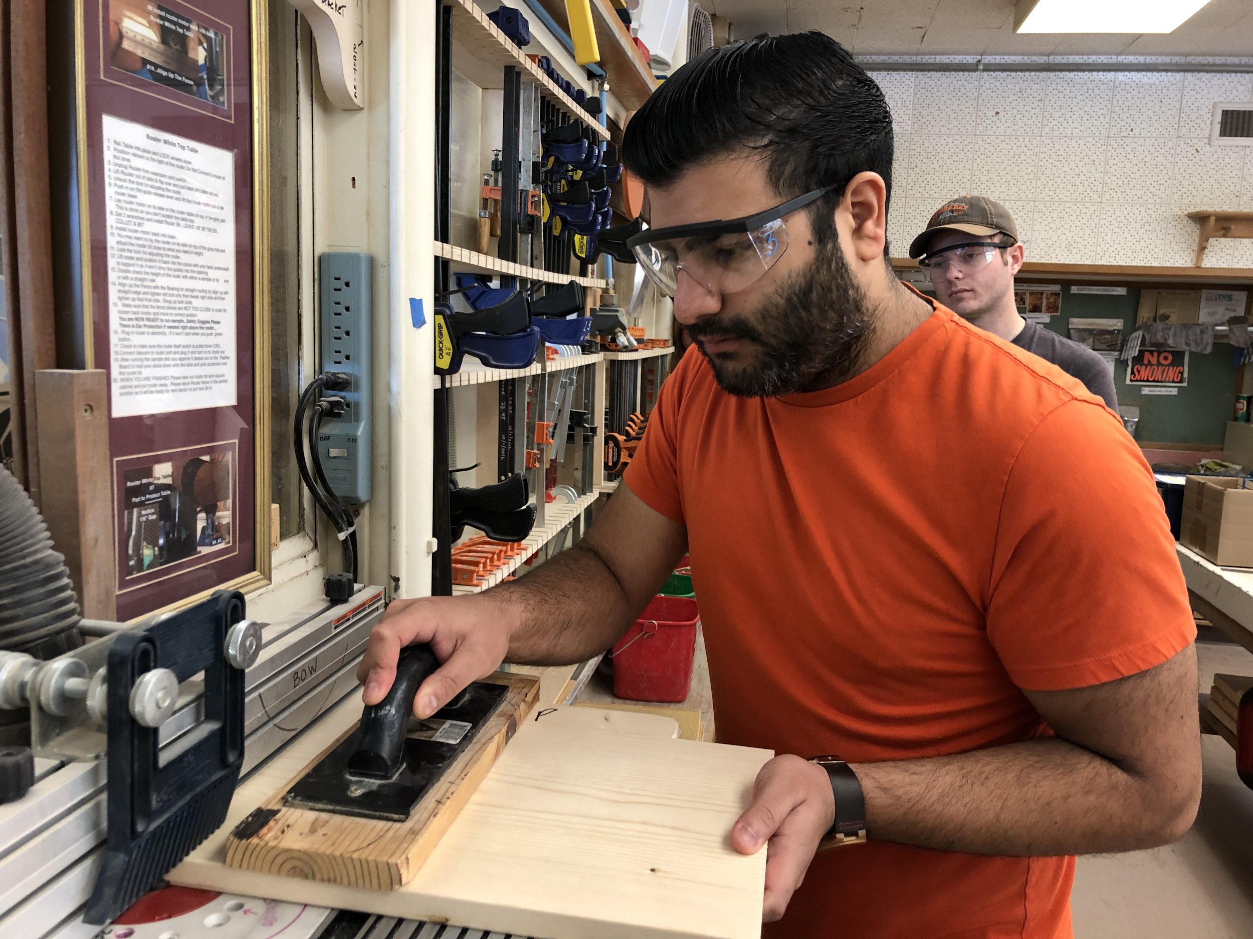
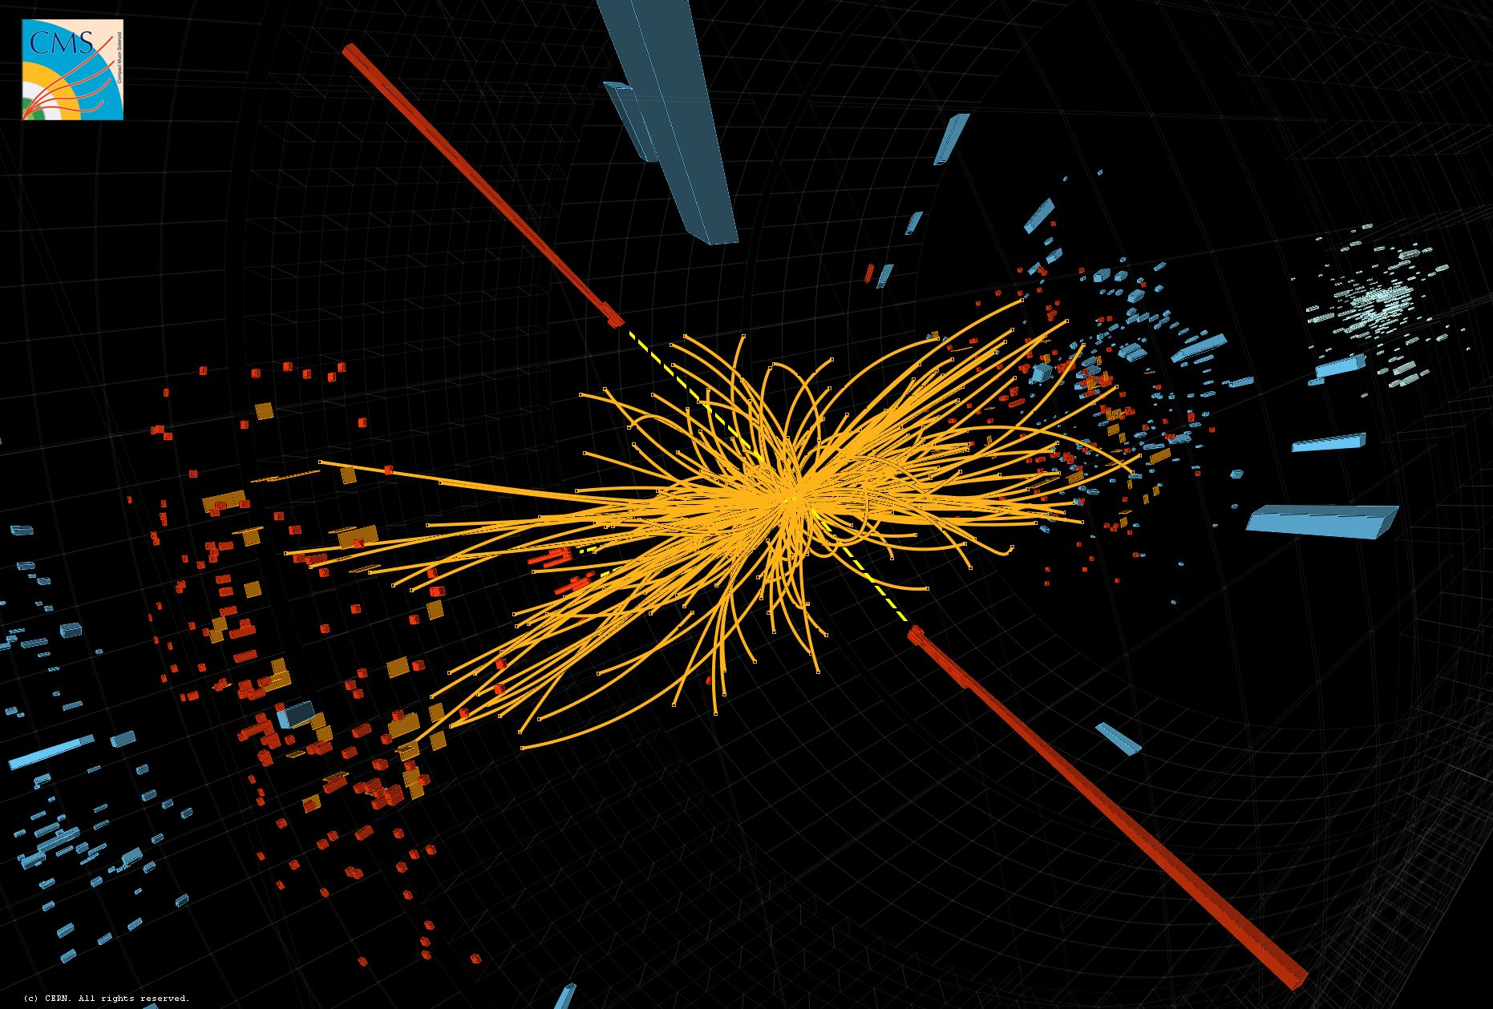

Rohan Bhandari, Ph.D.
www.github.com/RohanBhandari www.linkedin.com/in/rohan-bhandari/

Slide 19
Backup Slides

Slide 20
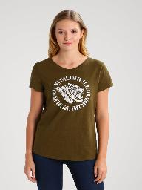
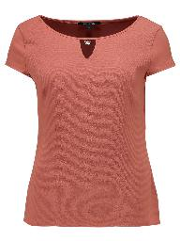
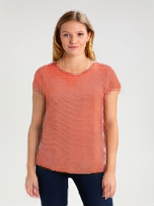
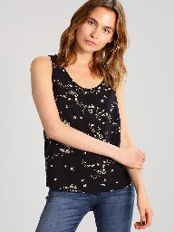
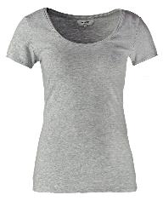
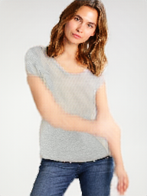
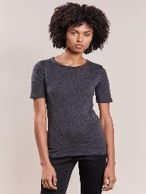
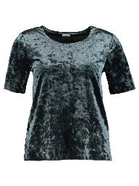
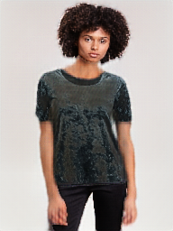
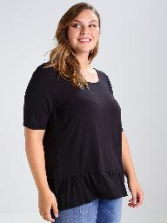
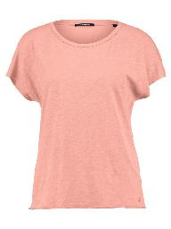
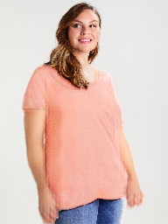
Additional Results

Slide 21
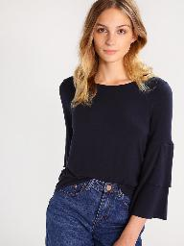
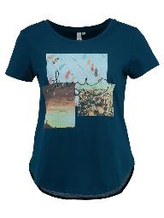
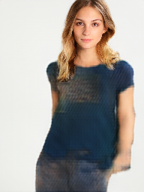
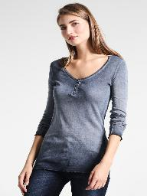
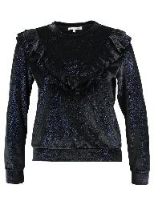
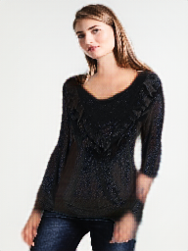
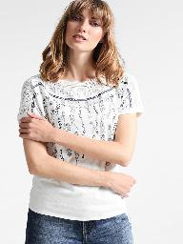





Failure Modes
Human parsing failure / Complicated design
Sleeve generation / Neckline
Unique poses
Sleeve removal

Slide 22


Competitors
2D Overlays
3D Scan/AR
No public image
(ZeeKit)
(AvaMetric)
Original clothing shows through
Limited poses
Customer must create 3D scan
Retailer must create 3Ds can for each item

Slide 23
Next Steps
Speed up pipeline
Collect more diverse data
Output higher-res images

Slide 24
Clothing Agnostic Person Representation
Person
Representation
Original Image
Pose Map
Body Mask
Face/Hair

Slide 25




Clothing Transfer: Coarse Step
Person Representation
Coarse Result
Target Image
Perceptual Loss
Selected Clothing
Shirt Mask
Target Mask
Multi-task Encoder-decoder
w/ Skip Connections
L1 Loss

Slide 26



Clothing Transfer: Refinement Step
Warped Clothing
Alpha Mask
Refined Image
Target Image
Coarse Result
Perceptual Loss
Notes:
Make own network image

Slide 27


Stacked Clothing Transfers
Notes:
Make own network image

